Slide 1


GOOGLE ONLINE MARKETING CHALLENGE POST - CAMPAIGN
SAN FRANCISCO YOUTH THEATRE
Ravi Kant | Alok Sheth | Shreyas Telkar | Sameena Sheikh | Palakk Shrivastava

Slide 2
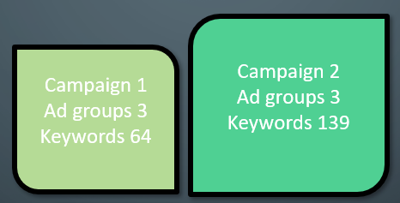
Campaign Overview
Campaign Strategy
Results
Recommendations
SFYT ADWORDS ACCOUNT
San Francisco Youth theatre is a performing arts organization based in San Francisco, California, dedicated to creating cutting-edge theater for children and youth.
The target for SF Youth theatre AdWords campaign was to increase awareness about the theatre for more viewership and boost traffic to the official website.
We created, 2 Campaigns, 6 ad groups with 203 Keywords and run the campaign for 25 days,
April 2 – April 26 on Google Search Network
Initial goals set as the Key Performing Indicators for the account were to reach a minimum CTR of 5.0% (Google standard) and increase the impressions.

Slide 3
Campaign Overview
Campaign Strategy
Results
Recommendations
Campaign 1 was launched with 3 ad groups and 6 ads with sitelinks, around 50 keyword.
Budget: $100, Maximized CPC
Week 1
( April 2 – April 6)
Campaign 1 started accumulating data, added keywords (64 total)
Impressions:61, Click: 2, CTR : 1.64%
Week 2
( April 7 – April 13)
Launched Campaign 2, 3 ad groups long tail keywords, Ads created for upcoming play; 283 Impression, CTR: 3.53%, Avg CPC: $1.63, Clicks 10
Week 3
(April 14 – April 20)
Optimization: Budget,bid strategy was not changed, alternate keyword added, continued monitoring, removing low performing keywords, total 16 ads
Week 4
(April 21 – April 26)

Slide 4
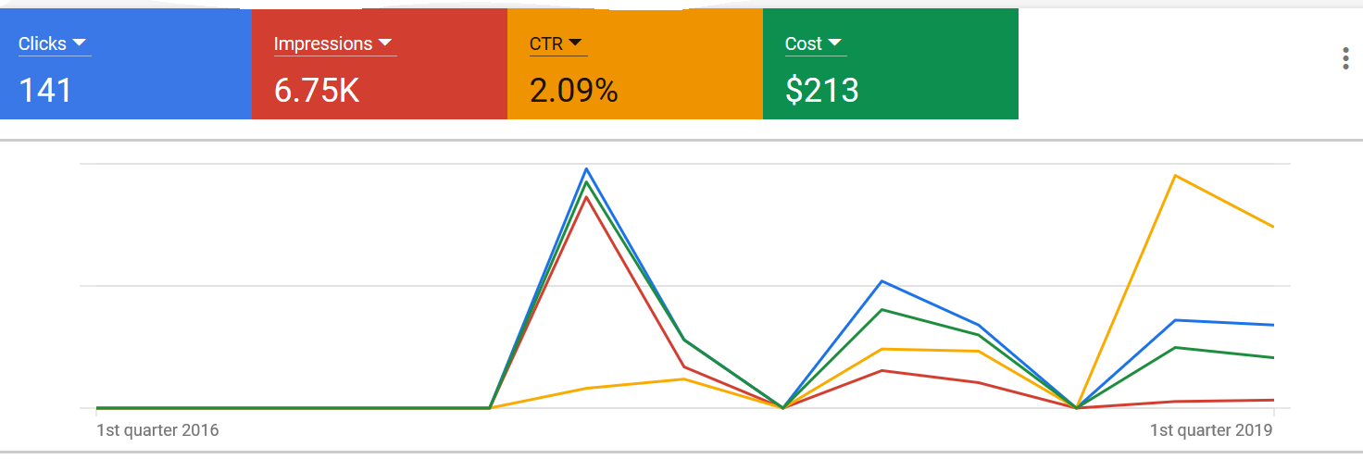
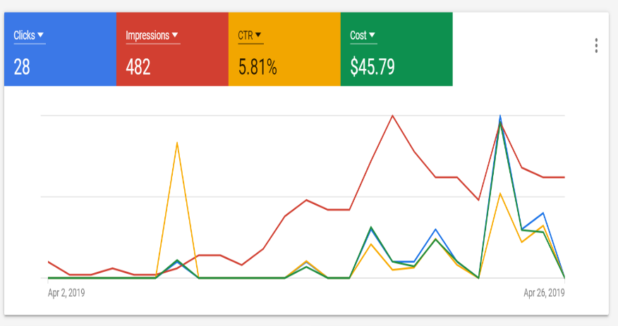
Campaign Overview
Campaign Strategy
Results
Recommendations
PRE-CAMPAIGN (Q1 2016 – Q1 2019)
36 months
POST-CAMPAIGN (April 2, 2019 - April 26)
25 days
CTR : 2.11%
IMPRESSIONS : Avg. 173/ month (6.75k total)
CLICKS : Avg. 4 / month (141 total)
Avg. CPC : $1.99
COST : $213
CTR : 5.84%
IMPRESSIONS : 482
CLICKS : 28
Avg. CPC : $1.64
COST : $45.79
CTR of 5.81% was a 275% increase from initial. The final click totals of 28 was achieved, which was a 600% increase and impressions increased by 180%

Slide 5
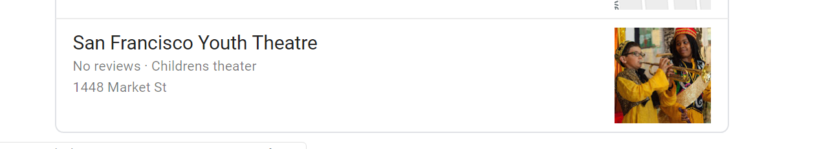
Campaign Overview
Campaign Strategy
Results
Recommendations
COVERSION TRACKING
Check conversion tags set up at the website level. They have not been set-up optimally and thus there is no conversion tracking in the account currently. This can be updated by the web developer
UPDATE LANDING PAGES
The quality score of the website had been low due to low CTR. The landing pages also have the information about the bygone plays in the landing pages.
ADD REVIEW
Since, it’s a creative theatre, a lot of viewership depends on the reviews and more visibility on social media. There is no reviews in the organic search. Thus, they can invite viewers to write a review as a promotion strategy
KEEP RUNNING AdMAG_UTD Campaigns
We would suggest SFYT to keep running our successful Campaign 2

Slide 6
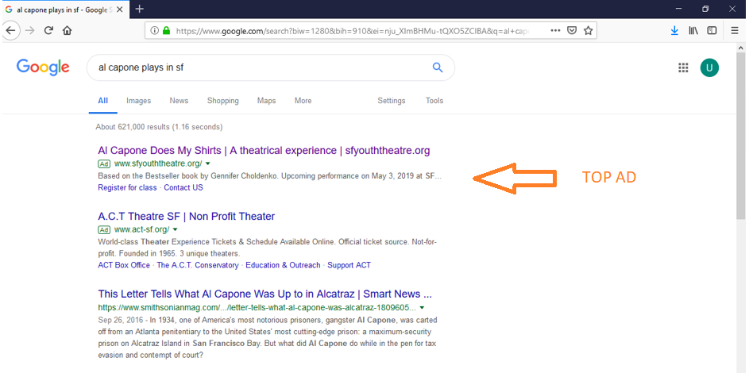
HIGHLIGHTS A D T O P P K E Y W O R D S
Search keyword | Clicks | Impressions | CTR | Avg. CPC | Cost (USD) | Avg. position | Avg. CPM | Quality Score (/10)
shows in san francisco | 1 | 37 | 2.70% | $1.97 | 1.97 | 4.14 | 53.24 | 4
plays in san francisco | 3 | 31 | 9.68% | $1.96 | 5.88 | 3.16 | 189.68 | 5
sf performances | 4 | 27 | 14.81% | $1.72 | 6.89 | 3.93 | 255.19 | 6
san francisco theater | 2 | 23 | 8.70% | $1.93 | 3.86 | 4.74 | 167.83 | 5
musicals in san francisco | 2 | 19 | 10.53% | $1.92 | 3.83 | 4.63 | 201.58 | -
Device | Impressions | CTR | Clicks
Tablets | 33 | 2.63% | 1
Mobile phones | 211 | 2.37% | 5
Computers | 233 | 9.44% | 22

Slide 7
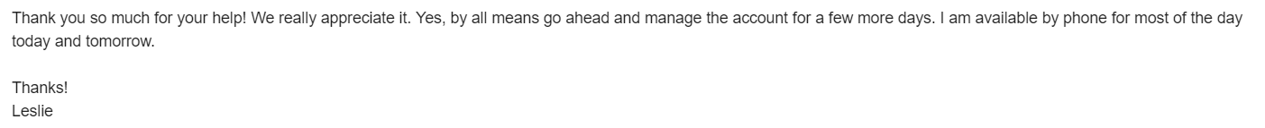

Happy Client!!
QUESTIONS?

